Slide 1
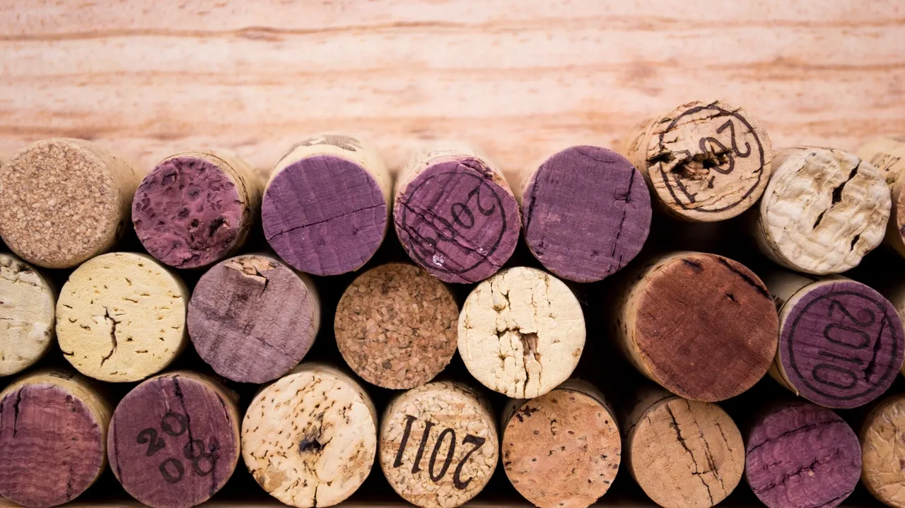
Wine Analysis

Slide 2
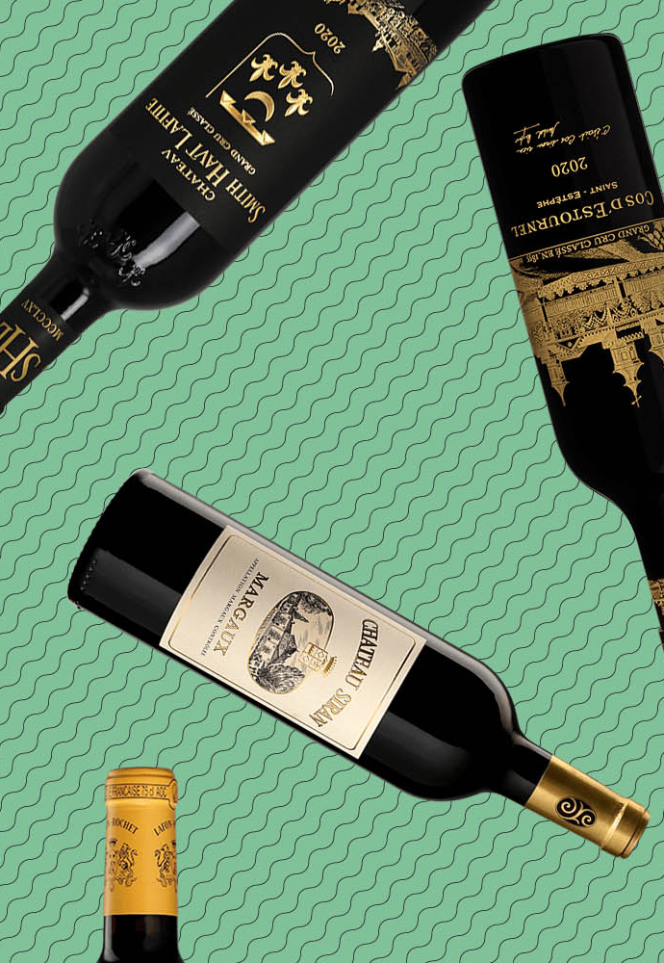
Project 4 Team 2
Kimberly Childers
Fernanda Valdez
Misha Borunda

Slide 3

PROJECT SUMMARY
This project utilizes three different data sets to do a comprehensive analysis about wine.
Two of the chosen datasets will be used for Machine Learning to train a model and make predictions about Red and White Wines based on their physicochemical composition.
In addition to the Machine Learning portion of the project, there will be an analysis and visualization done on Tableau to portray insights from the datasets and create an interactive way for users to learn about wine types and quality and the variables that affect it.
At the end of the project, there will be a Full Stack Web Application combining our ML Research, BI dashboards, and Reports about Wine, its quality and other characteristics.

Slide 4

Data sets
Wine Quality Data Sets
One data set if for Red Wine only and the other one is for White Wine only
Both Datasets include the same physicochemical variables
https://www.kaggle.com/datasets/uciml/red-wine-quality-cortez-et-al-2009?resource=download
https://www.kaggle.com/datasets/piyushagni5/white-wine-quality
Wine Reviews Data Set
includes Wine regions, points and prices
https://www.kaggle.com/datasets/zynicide/wine-reviews

Slide 5

DatA CLEANING
Two data sets were merged for the ML portion of the analysis to be able to create a model to predict wine types (Red vs White) based on physical and chemical characteristics
There were no Null-Values, therefore rows of data did not need to be dropped
A new column “wine_type” was created to identify wine types in the combined data frame
One-Hot encoding was used to classify red wines as “1” and white wines as “0”
We had “Unbalanced” Data since 67% of Wines were White and only 33% were Red
SMOTE was used to balance the data

Slide 6

Definitions
Fixed Acidity
Is the set of the wine’s natural acids
It preserves the wine’s natural qualities, as well as its color
Volatile Acidity
Is a measure of a wine’s gaseous acids
The amount of VA in wine is often considered an indicator of spoilage
Citric Acid
It can be added to finished wines to increase acidity and give a “fresh” flavortive or additive to food or drink to add a sour taste
Residual Sugar
It is the natural grape sugars leftover in a wine after the alcoholic fermentation finishes
Chlorides
Depend on the geographic, geologic and climatic conditions of vine culture
The content is increased in wines coming from vineyards which are near the sea coast
Free Sulfur Dioxide
Sulfur Dioxide Ions that are not chemically bonded to other chemicals
Too much sulfur in wine can cause danger to health if drank excessively
Density
Mass/Volume – How “heavy” the wine is
PH
Influences the taste of the final product, but also its color, oxidation and chemical stability.
Alcohol

Slide 7
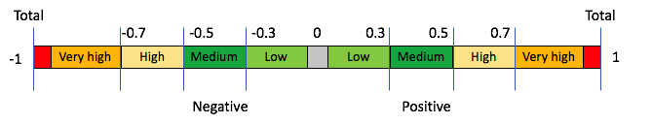
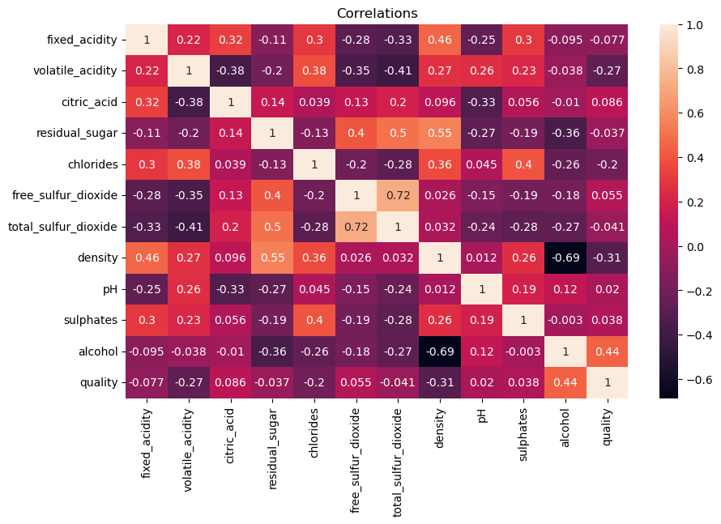
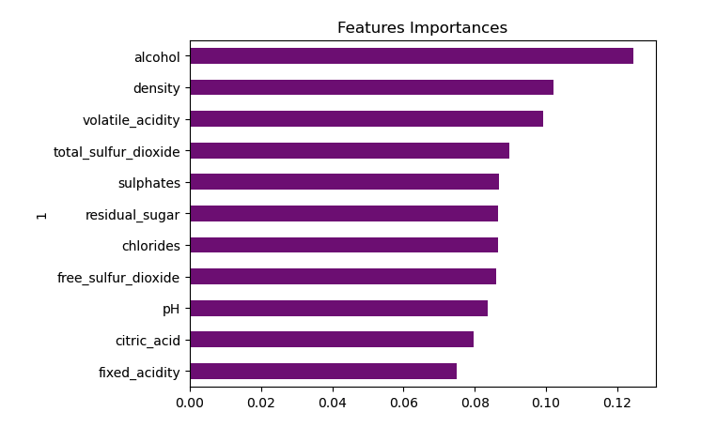
Ml model 1
Predict Wine Quality based on its physical and chemical properties
Alcohol, Density and Volatile Acidity were the only features that presented a “Moderate” Correlation
Since there were no strong correlations, we decided to change our model to predict wine type (Rev vs White) instead

Slide 8
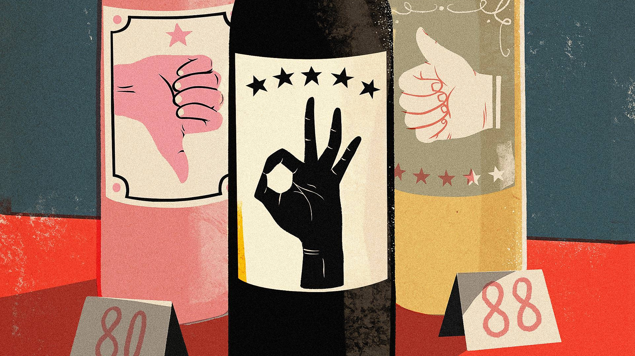
Ml model 1 findings

Slide 9
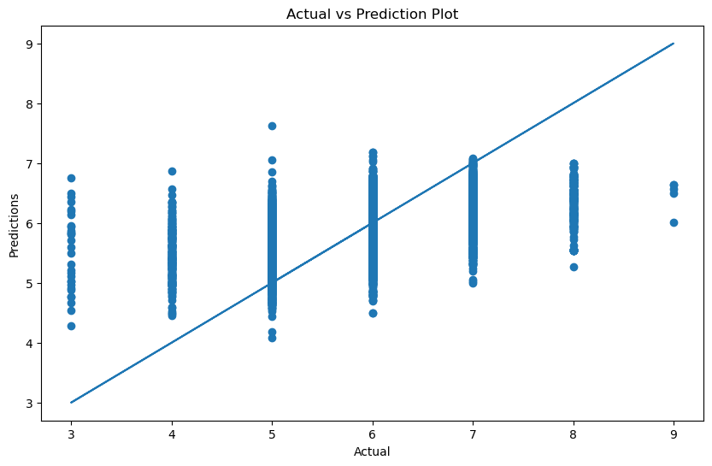
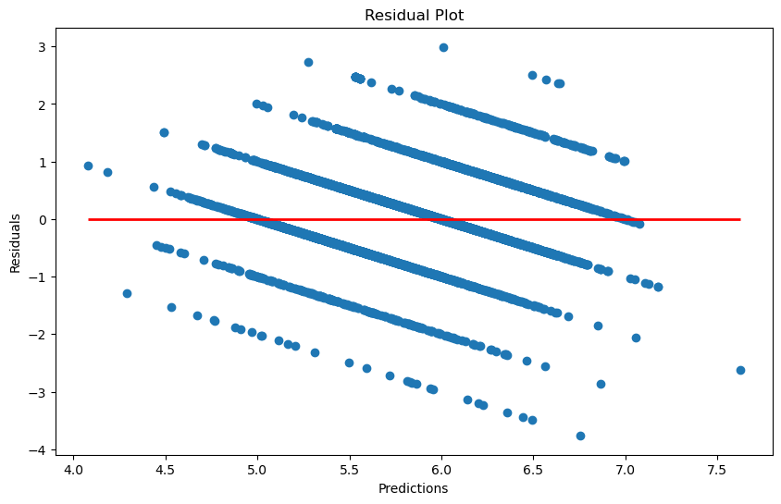
Linear Regression

Slide 10
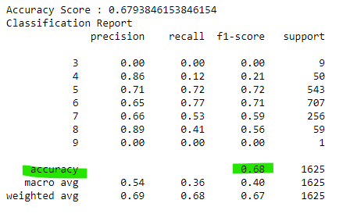
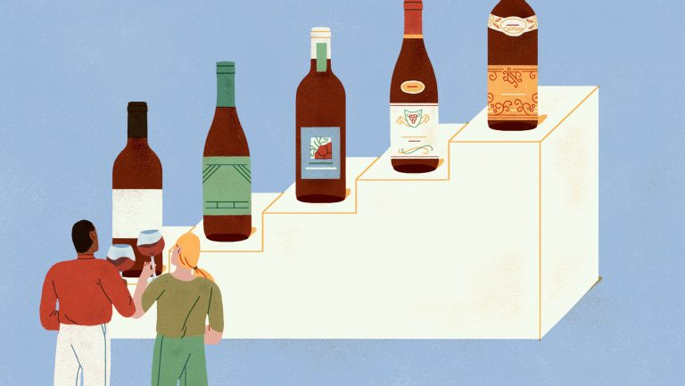
Random Forest

Slide 11

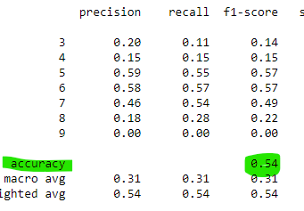

KNN

Slide 12
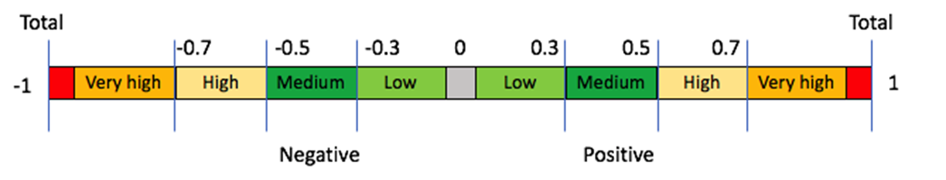
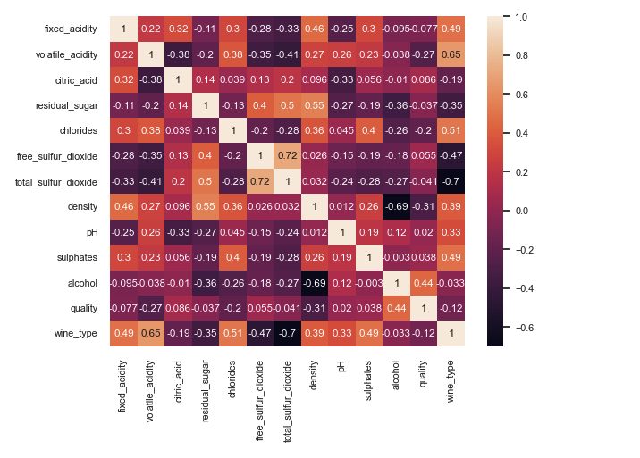
ML model 2
Predicts wine type (Red vs White) based on physical and chemical properties
Out of 11 features considered, 9 of them had moderate to strong correlations with wine type.
The strongest correlations being Total Sulfur Dioxide (-0.7), Volatile Acidity (0.65) and Sulfates (0.49)

Slide 13
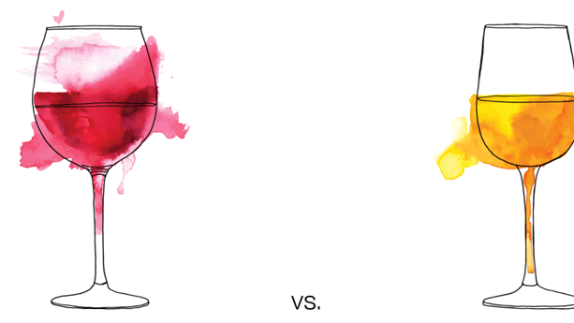
Ml 2 FINDINGS

Slide 14
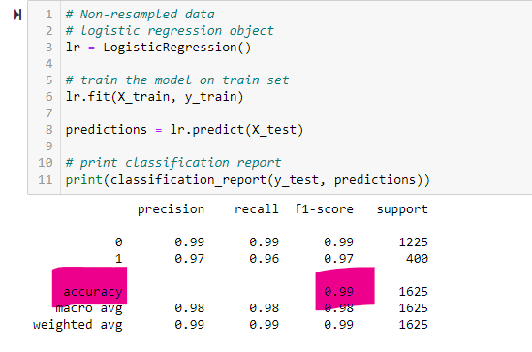
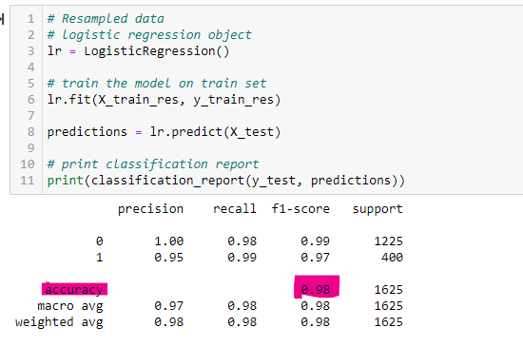
Logistic Regression - SMOTE
Before balancing data
After balancing data

Slide 15
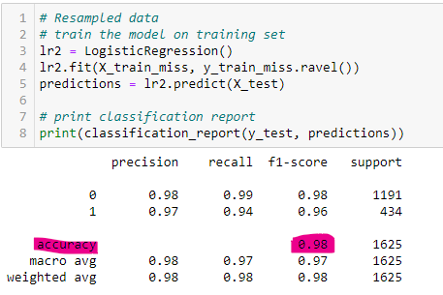
Logistic Regression – NEARMISS
Before balancing data
After balancing data

Slide 16
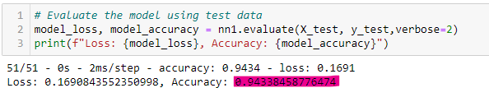
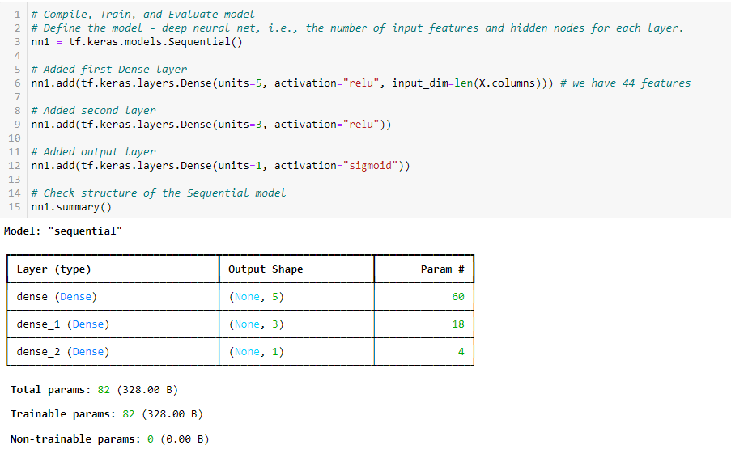
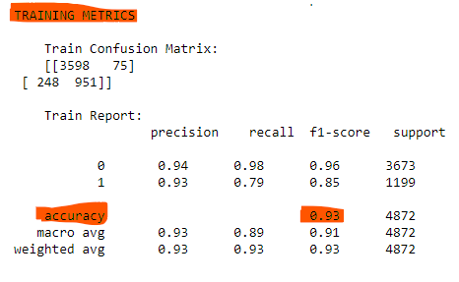
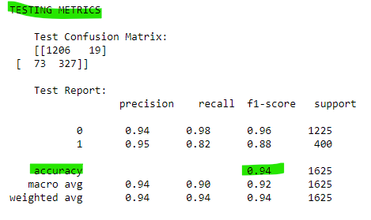
NEURAL NETWORK NN1

Slide 17
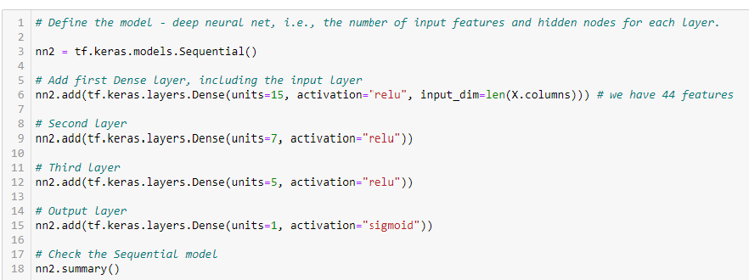
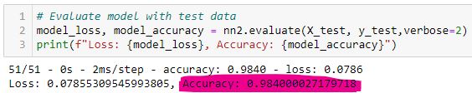
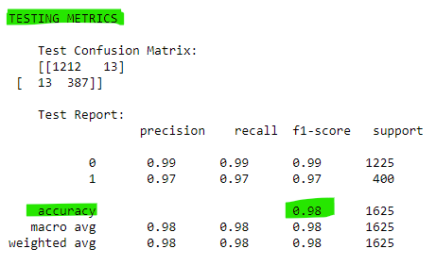
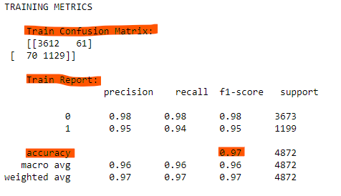
NEURAL NETWORK NN2

Slide 18
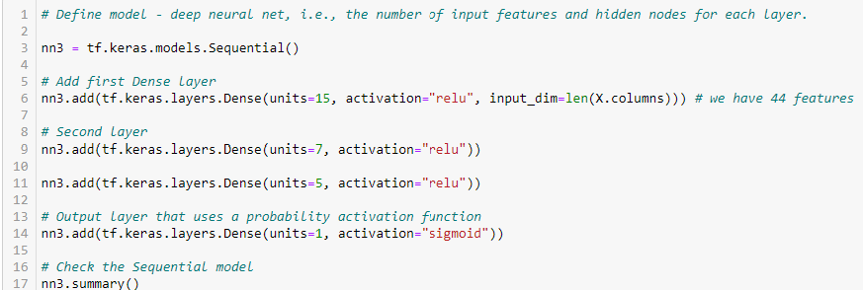
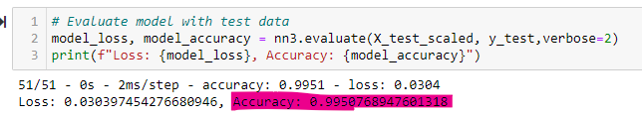
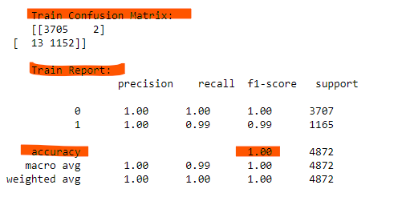
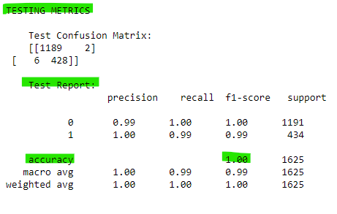
NEURAL NETWORK NN3

Slide 19
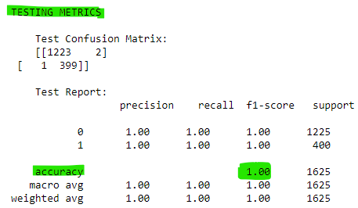
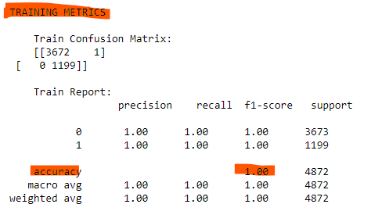
XGB

Slide 20
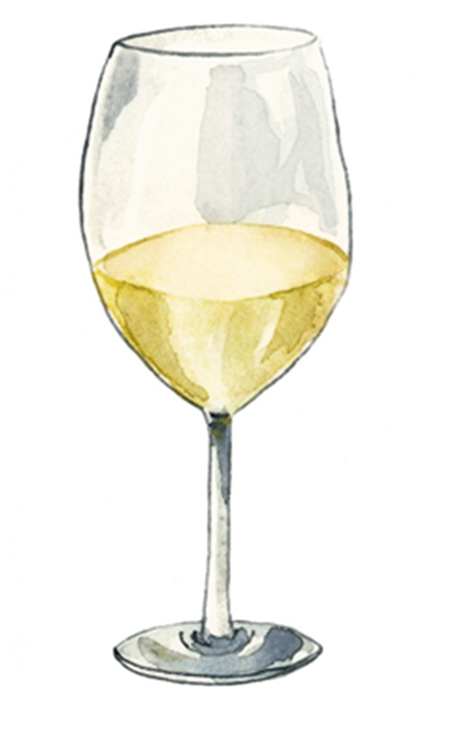
tABLEAU

Slide 21

conclusion
Red and White Wines are relatively “easy” to distinguish based on their properties and therefore it makes sense that our machine learning models have high accuracy
Quality has only a moderate correlation with the physical and chemical properties of wine and therefore the machine learning models presented a lower level of accuracy

Slide 22

REFERENCES
https://agrovin.com/en/techniques-for-correcting-wine-acidity/#:~:text=Fixed%20acidity%20is%20the%20set,of%20tartaric%20acid%20per%20litre.
https://www.wineenthusiast.com/basics/drinks-terms-defined/volatile-acidity-wine/
https://wineserver.ucdavis.edu/industry-info/enology/methods-and-techniques/common-chemical-reagents/citric-acid
https://winefolly.com/deep-dive/what-is-residual-sugar-in-wine/
https://wineamerica.org/the-magic-of-wine/wine-facts/
https://www.randoxfood.com/why-is-testing-for-free-sulphite-so2-important-in-winemaking/#:~:text=The%20sulphur%20dioxide%20ions%20that,to%20health%20if%20drank%20excessively.

